Slide 1
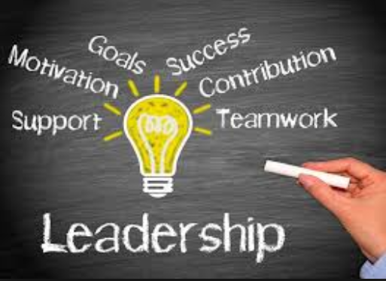
LEADERSHIP INTERVIEW
Student Name
Institution
Date

Slide 2
importance of the leader’s role to the organization
The classic model of organizational leadership reveals that leader is a top executive who control various aspects of organization
It operates through a hierarchy of individuals to bring stability to an organization.
The leadership concept has evolved for making an organization successful
A leader influences people to efficiently complete tasks and motivates them.

Slide 3
Good leadership
Good leadership is felt throughout the organization with effective communication of the leader to promote vision and goals of the company
Leaders develop strategies to help companies meet goals.
Leaders are key human resources in the organizations to achieve higher levels of performance and maximize efficiency of line managers
Leaders help to clarify and communicate company’s vision to their teams.
Leaders communicate policies and strategies to teams to transform the culture of an organization.

Slide 4
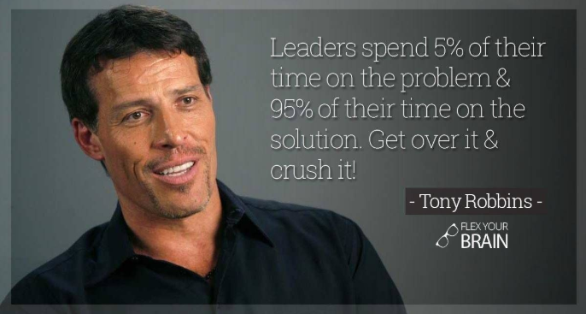
Importance of leader in organization
Leaders provide an organization with a structured approach and generate an action plan to effectively achieve goals
Leaders show dedicated, enthusiasm, and commitment to become a key source of motivation and inspiration
Leaders provide encouragement to individuals to promote new innovative ideas to improve the quality of work and products.
Leaders form engaging relationships with employees to create a sense of ownership and belonging

Slide 5
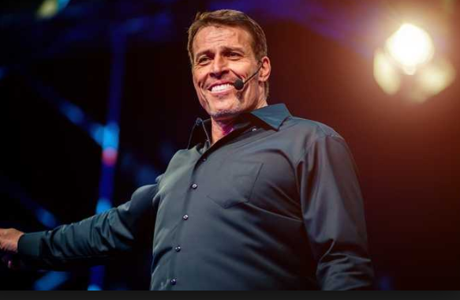
The Leader Chosen: Tony Robbins
A good leaders shows attributes of honesty, confidence, drive, focus, enthusiasm, transformation, and charisma
Tony Robbins born 1960 is a renowned American author, life coach
He is a philanthropist known for his books, coaching and training, and leadership development programs
Tony Robbins Research International organizes seminars around the globe for self-improvement and personal transformation

Slide 6
Roles and Responsibilities
Tony Robbins emerged as an influential motivational speaker since the 1980s
It has worked to transform the lives of Bill Clinton, Justin Tuck, Serena Williams, and American businessmen.
Robbins speak about human needs and making powerful decisions in his seminars conducted by his organization with perfect mastery and charisma.
Anthony Robbins Foundation help the youth, helpless, prisoners, and homeless people to become good citizens

Slide 7
Effectiveness of the Chosen Leader
As a life coach and motivational speaker, Tony Robbins is a genuine leader in the United States
To play a role of mentor and a trainer for all the top entrepreneurs and students.
He performs his duties with extreme enthusiasm to change the lives of people on a global scale.
Tony possesses the drive, passion, and knowledge to help people realize their potential and bring out their best.

Slide 8
Personal Leadership Style
Tony Robbins is a respected leader in the global community with millions of followers and students on the social media who follow his style.
He makes his own decisions and takes responsibilities for his actions.
Tony adopts a transformational leadership style that ensures maximum participation and appreciation of his team members to deliver the best services to clients worldwide.
Tony efficiently participates in policy making, develops strategies, write books, and deliver training sessions to grow his team and organization continuously.

Slide 9
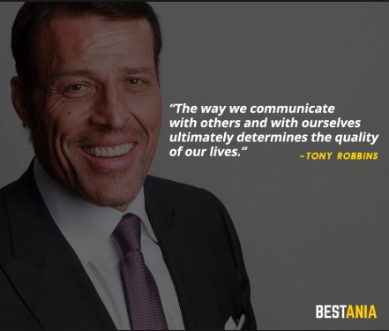
Leadership styles
Tony Robbins demonstrate multiple leadership styles such as transformational leader, situational leader, and an innovated leader.
Tony believes a philosophy of leadership that combines different leadership styles to influence his employees
Junior trainers with creative ideas.
He demonstrates the role of practicing innovation in his leadership

Slide 10
Leadership approach
Toni's leadership approach helps to develop the organization, support achievement of his mission and goals, and help the team of trainers to think and deliver sessions innovatively.
Tony has introduced a new role for the global leaders to achieve success using creative efforts and personal charisma
Therefore, communicating effectively at all levels is a major positive trait of Toni's leadership style.

Slide 11
Personal Values
Tony Robbins possesses and demonstrate the following personal values:
Respect for himself and others
Making difference in own life and in other’s lives.
Integrity and honesty.
Authenticity
Service attitude
Courage and determination.
Wisdom and humility.

Slide 12
How Tony Robbins can Influence the Future Generations
As a brilliant and motivational life coach, Tony Robbins can influence the lives of millions of young people and future entrepreneurs.
By coaching leadership and motivational skills to deprived people
Tony can change the lives of many living under harsh conditions and suffering injustice
Tony can help thousands of women in the world to live a meaningful life and understand their rights and talents

Slide 13
Impact on performance of government
Tony can impact the performance of government officials and future politicians
He already acted as a personal coach of Bill Clinton and many other beaurocrats
Tony can help the students community to deal with challenging situations during an economic downturn
It use their skills to maximize their chances of success
Tony can help to build a better society and transform the fate of nations in the future.

Slide 14
References
Core Leadership Values | Mason Leads | George Mason University. (2019). Retrieved from https://masonleads.gmu.edu/about-us/core-leadership-values/
Patricia Perry, Speed, GCC ACC. (2014). The Coaching of Age in the Age of Coaching: What Matters When You Don't Have All the Time in the World?. Gestalt Review, 18(2), 154. doe: 10.5325/gestaltreview.18.2.0154
Tony Robbins on the Psychology of Extraordinary Leaders. (2019). Retrieved from https://www.inc.com/james-ledbetter/tony-robbins-on-the-psychology-of-extraordinary-leaders.html

